Slide 1

HANDS-ON WITH REACT
Events

Slide 2
Handling events
In order to respond to user interactions like clicking, hovering, and focusing, you’ll need to add event handlers to your elements.
This is an extension of the learning completed in the JavaScript content and can be used extensively in JSX
Notes:
This is a simple extension of events in vanilla JavaScript. We will focus on onClick and buttons for the purposes of these projects

Slide 3
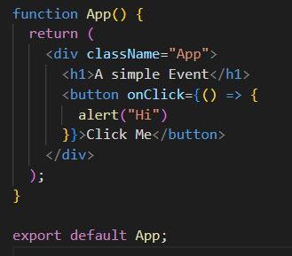
Handling events
These function identically in JS, but remember, in react any pure JavaScript must be put in curly braces. E.g.
The anonymous function stops automatic processing of the script

Slide 4
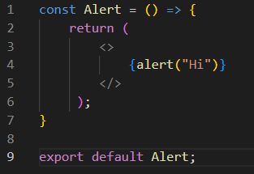
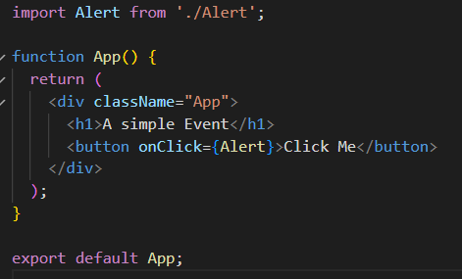
Handling events
We tend to put the outcome of these events inside a component and import when needed

Slide 5
QuickLab 7
Event Handling

